Slide 1
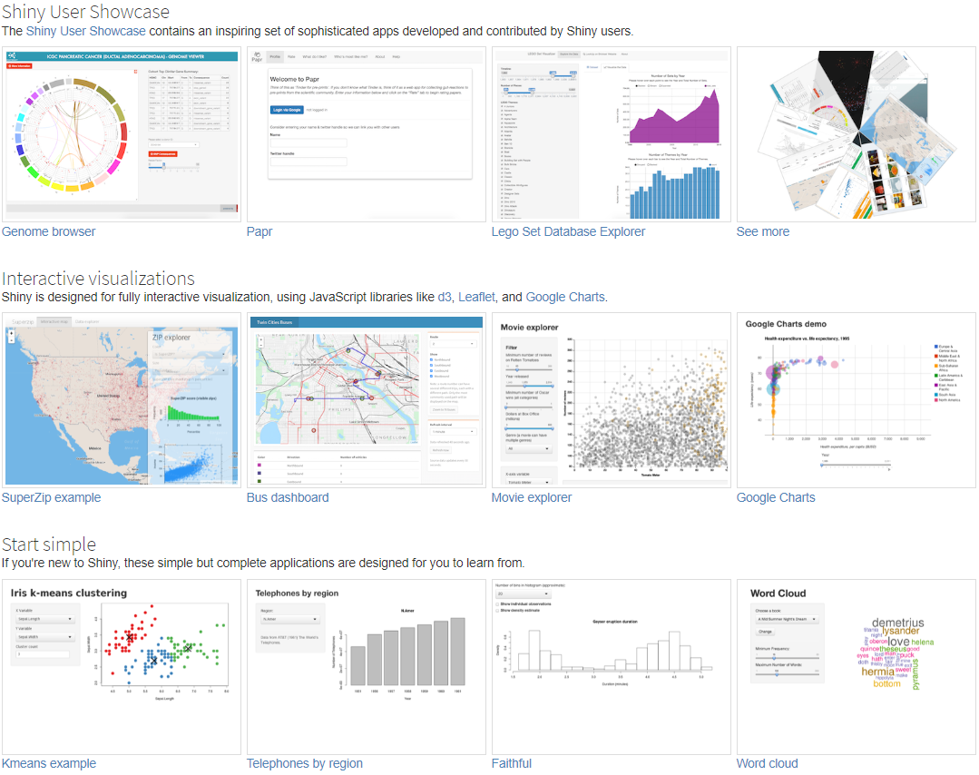
RShiny programming and its application on sample size in medical device
Ning Li
26 Sep 2019
Notes:
The focus of this presentation is to demonstrate the building of Shiny Apps rather than a detailed discussion of Shiny components and how to deploy Apps on the Web

Slide 2
Agenda
A hypothetical example
R Shiny applications in pharmaceutical industry
R Shiny for sample size estimation of medical device

Slide 3

A hypothetical example
Research Manager (RM): How many subjects are at least required for a MR trial based on NMPA guidance?
Biostatistician (BIOS): 54 subjects.
RM : But our budget is limited, can we reduce the sample size?
BIOS: If the expected proportion of acceptable image sets is above 90%, sample size is smaller than 54. Can you provide me the expected proportion?
RM: I only know our expected proportion is ranging from 91% to 96%. Can you help me calculate the corresponding sample size?
BIOS: Ok. The bigger expected proportion is, the smaller the sample size is. I will send you the sample sizes by email.

Slide 4
One hour later
Biostatistician sends the below result to research manager
Expected proportion | Sample size
0.91 | 47
0.92 | 41
0.93 | 35
0.94 | 31
0.95 | 27
0.96 | 24
For this simple calculation, Biostatistician can calculate the sample sizes quickly. For the complicated cases, such as, the expected proportion ranging from 0.01 to 0.99, Biostatistician need to produce a very long table to demonstrate the sample sizes. Is there any more efficient method?

Slide 5

Sample size is like a fish, what is fishing tool to fish sample size
R shiny is a interactive fishing tool to calculate the sample size

Slide 6
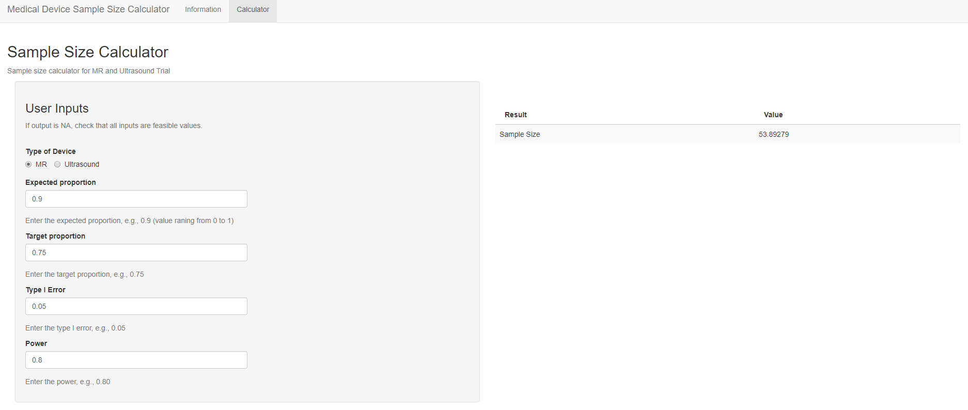
A rshiny app website for sample size
https://kangrinboqe.shinyapps.io/sample_size/

Slide 7
R shiny
What is R shiny?
Shiny is an open source R package that provides an elegant and powerful web framework for building web applications using R. Shiny helps you turn your analyses into interactive web applications without requiring HTML, CSS, or JavaScript knowledge.
Benefits for statistician & programmer:
Automate route tasks with great efficiency
Interactive data visualization in web and accessible from anywhere
Similar to SAS macros but more dynamic, interactive, powerful
Benefits for non-programmer
Accessible to non-programmers, easy to use without requiring R knowledge

Slide 8
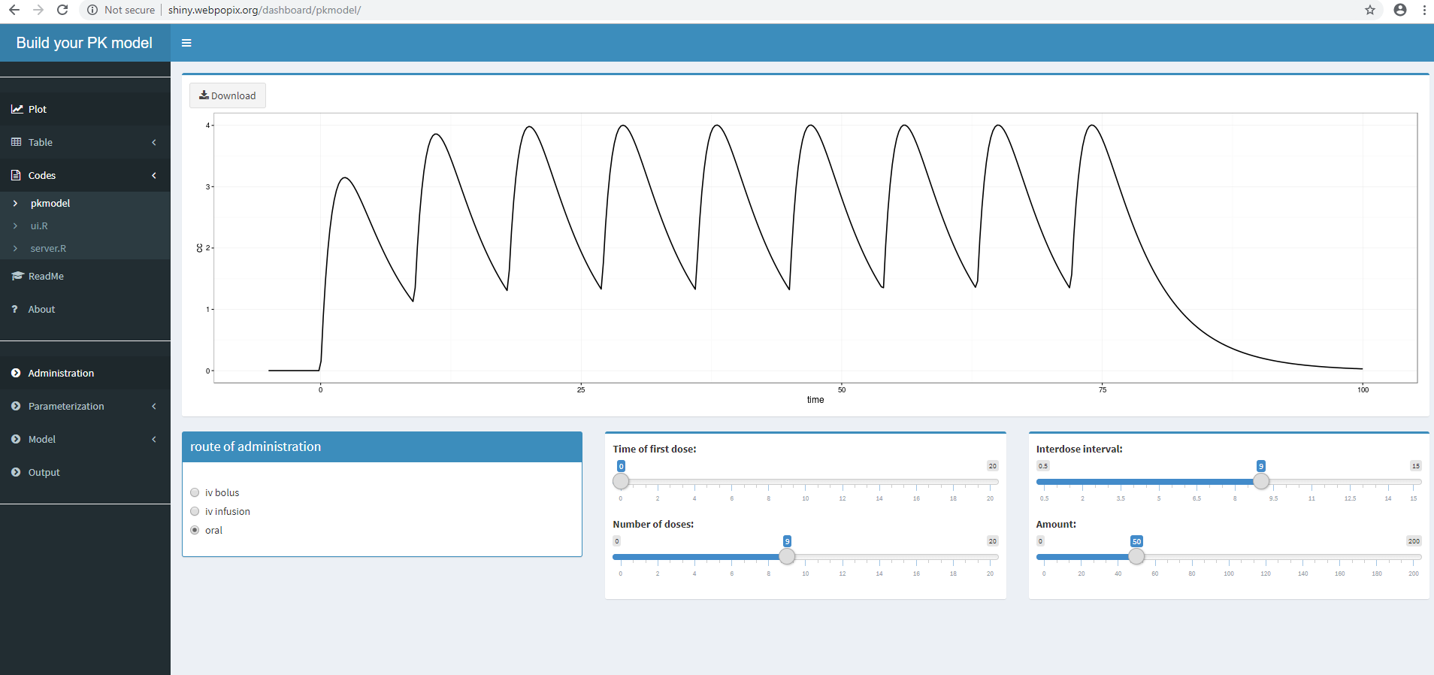
Pharma examples
Build your PK model by Marc Lavielle using the mlxR package (http://shiny.webpopix.org/dashboard/pkmodel/)
Bioequivalence v0.3 by Andrey Ogurtsov (https://statist.shinyapps.io/bioeq_en/)
FDA AE Dashboard (https://diabetescheck.shinyapps.io/openfda-dashboard/)

Slide 9
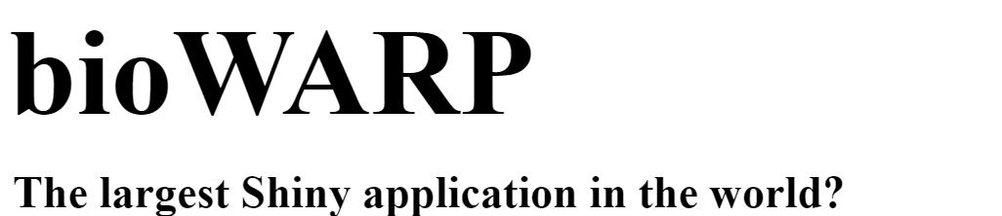
Medical Device example
bioWARP (biostatistical Web-Applications and R Procedures) is a Shiny application enabling employees at Roche Diagnostics to create validated reports for regulatory authorities submissions. bioWARP enables people using advanced statistical methods, who cannot program R.
It builds a connection to the validated R-packages developed at Roche with an easy to use and elegant user interface. Its modular environment can host an unlimited number of such interfaces.
bioWARP’s most important feature is the ability to move all statistical evaluations right into PDF reports. These are validated and can directly be used for submission to regulatory authorities.

Slide 10
My first R shiny App –Sample size calculator
https://kangrinboqe.shinyapps.io/sample_size/

Slide 11
Two steps to develop a R shiny web app
Write R shiny programming code
R Studio – New File – Shiny Web App – Shiny Programming code
Publish Shiny app on the web with Shinyapps.io
Shinyapp.io Account – Publish shiny

Slide 12
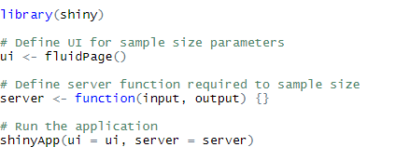
Shiny App Programming Template
User Interface
Server Function
Run the application
Notes:
Ui – nested R functions that assemble an HTML user interface for your app; fluidPage - Create a page with fluid layout
Server – a function with instructions on how to build and rebuild the R objects displayed in the ui
shinyApp-combines ui and server into a functioning app

Slide 13
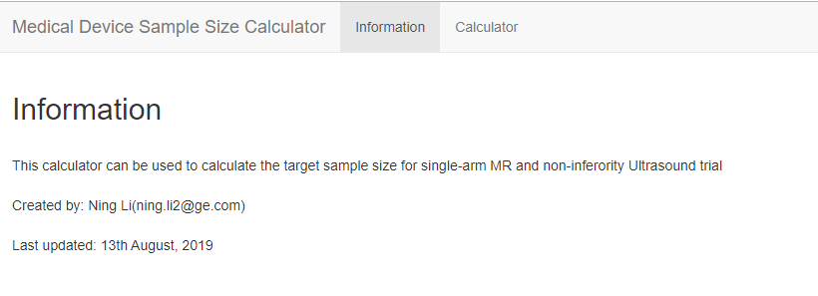
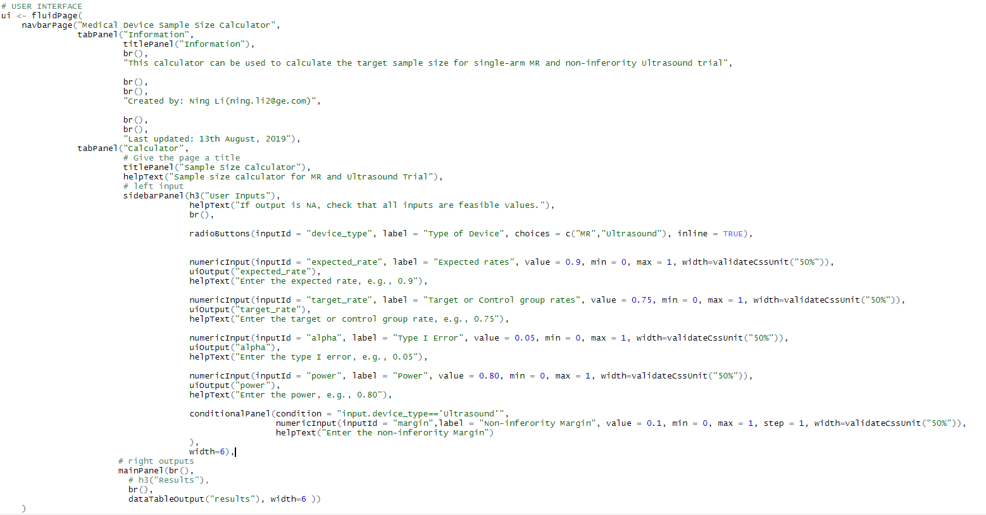
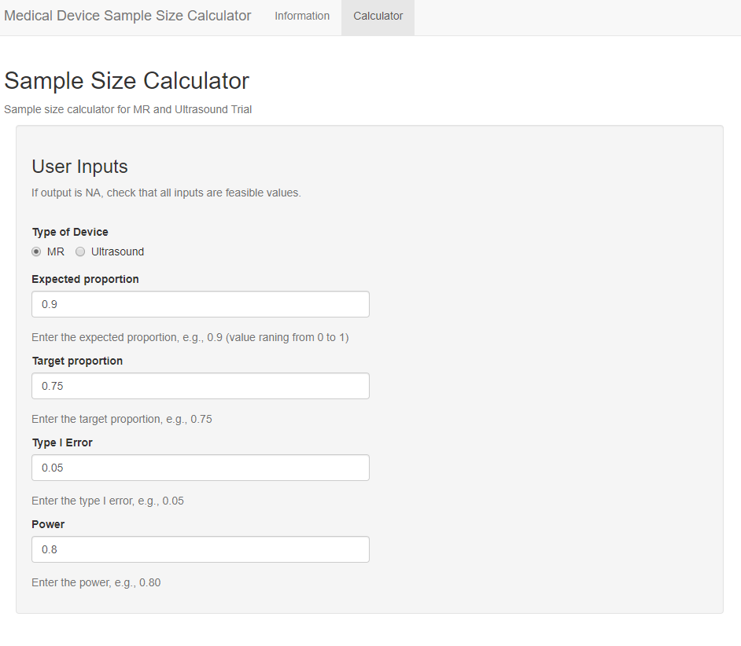
User Interface

Slide 14
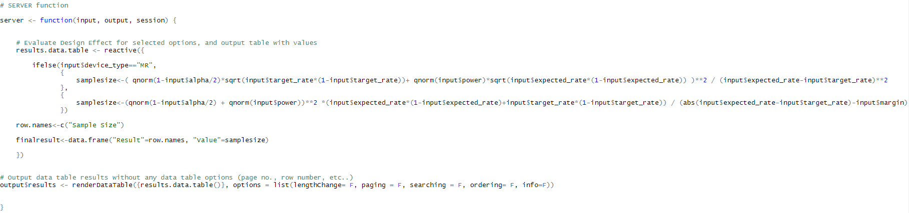
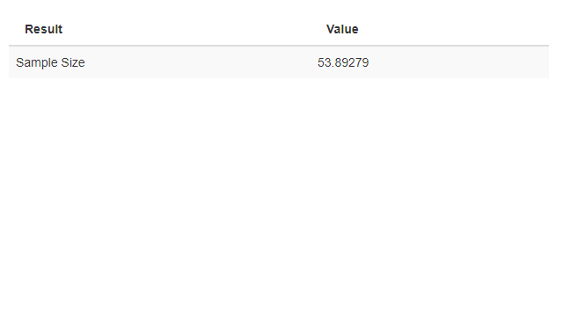
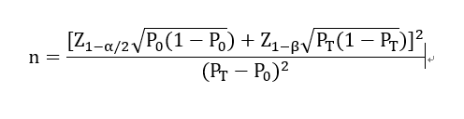
Server Function

Slide 15
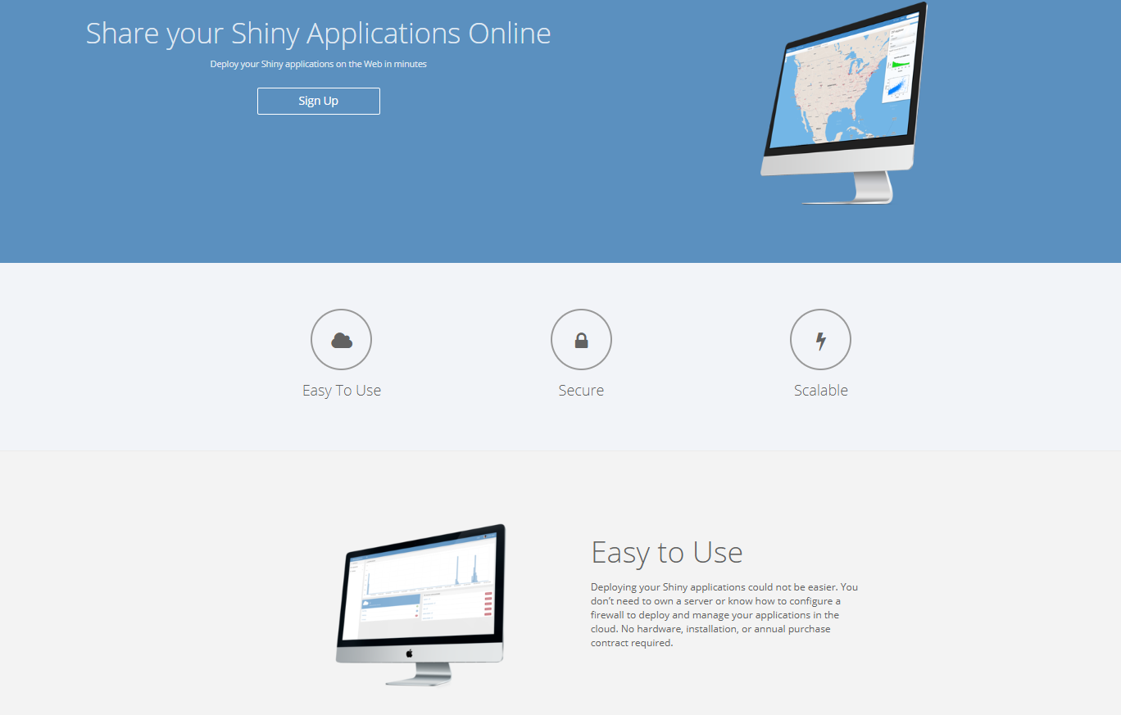
Share your Shiny Application online

Slide 16
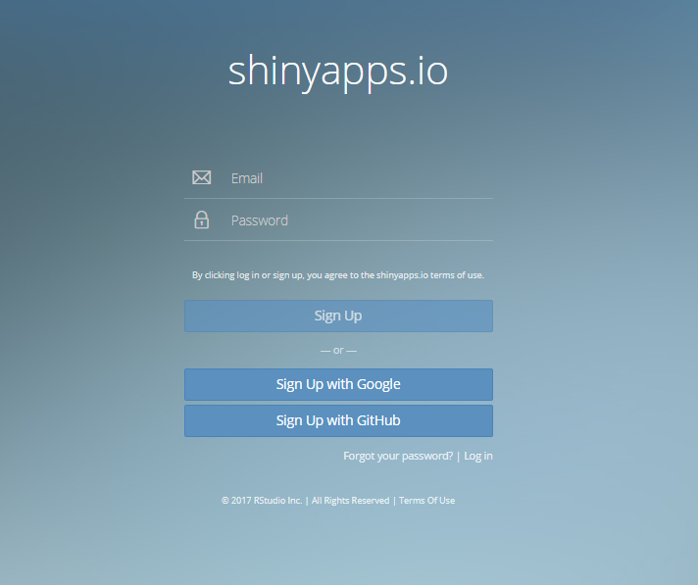
Create a shinyapps.io account
https://www.shinyapps.io/admin/#/signup

Slide 17
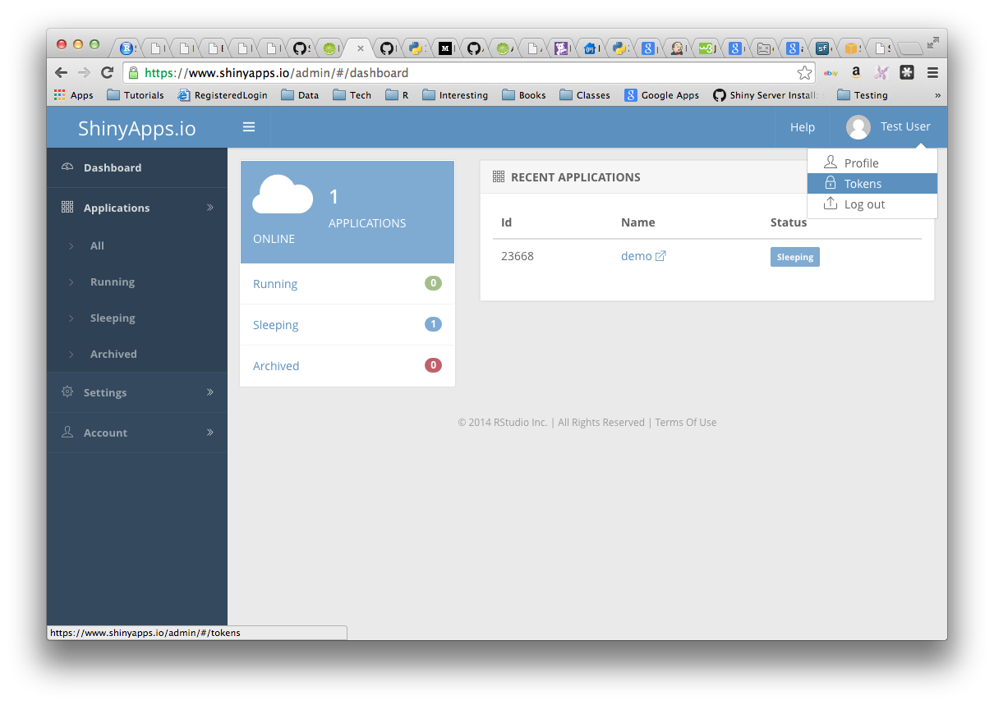
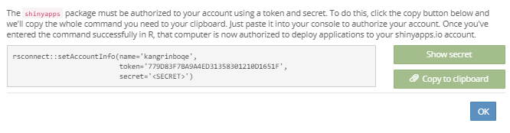
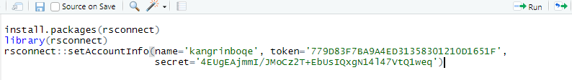
Connect R Studio IDE to shinyapps.io account

Slide 18
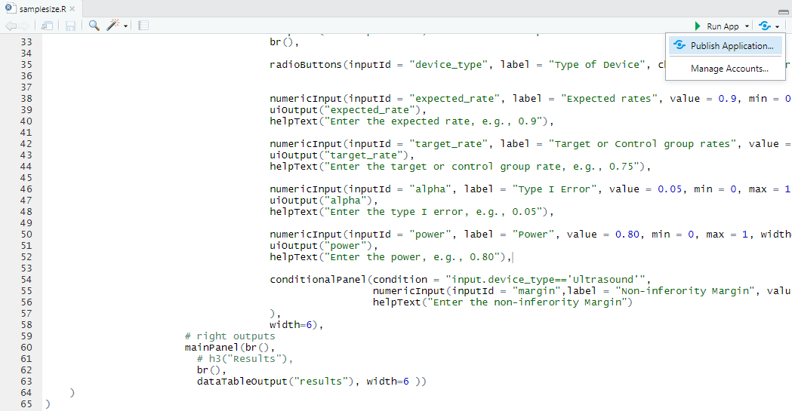
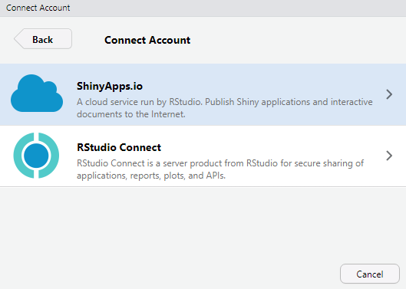
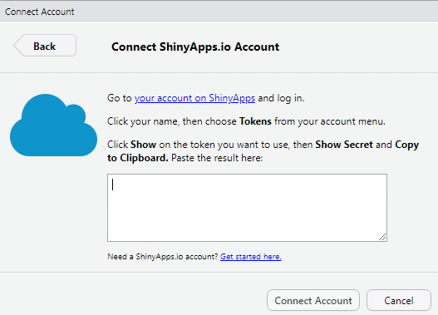
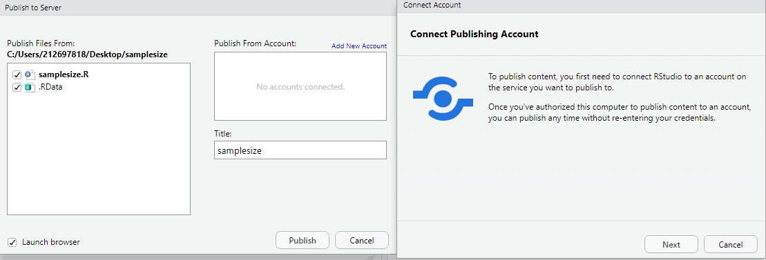
Publish the R shiny application to the server

Slide 19
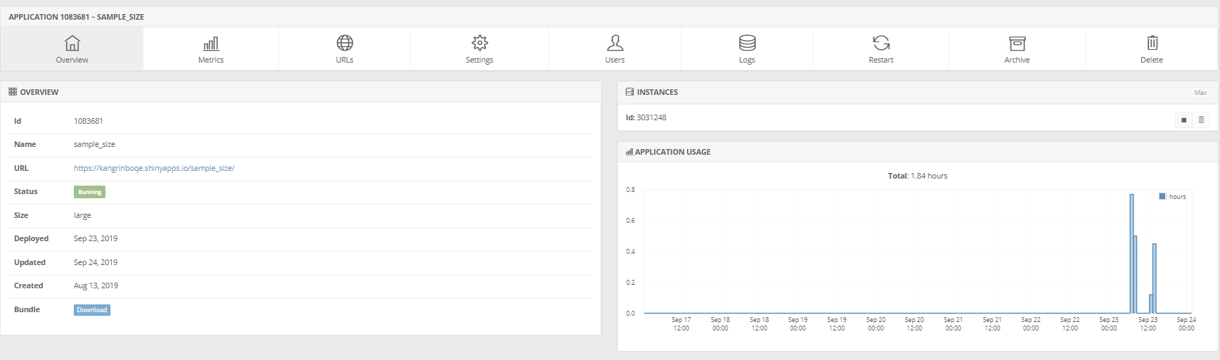
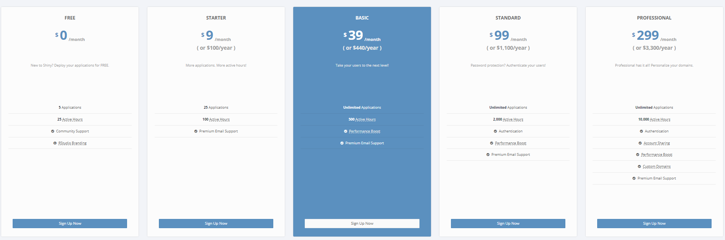
Shiny is free?

Slide 20
Reference
Shinyapps.io user guide:
https://docs.rstudio.com/shinyapps.io/index.html
Shiny Tech Document:
https://cran.r-project.org/web/packages/shiny/shiny.pdf
Other references:
https://beta.rstudioconnect.com/content/2759/#1
http://www.copafs.org/UserFiles/file/2018FCSM/H-2Wong.pdf
https://rinpharma.github.io/website2018/program/the-team.html

